Slide 1
Water Quality Diagnosis
By Jin Hyeok Noh
Brown Data Science Initiative
Date: 10/15/2021
GitHub Repository: https://github.com/jinnoh47/data1030-project/blob/main/project.ipynb

Slide 2
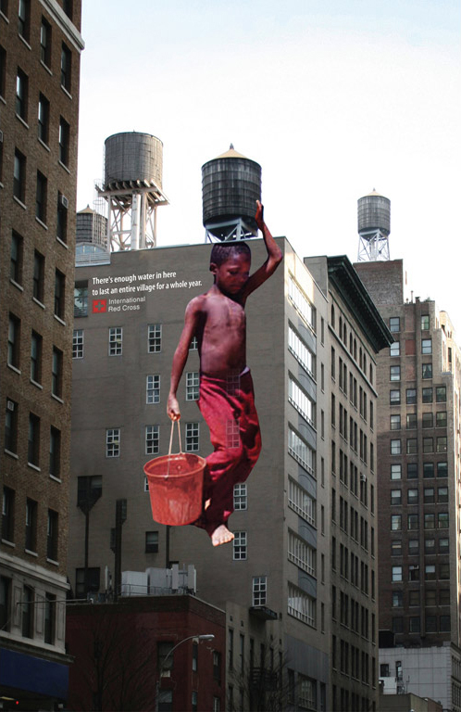
Introduction
There's enough water in here to last an entire village for a whole year.
Investing on water supply and sanitation can deliver net economic benefits. This is because the negative health impacts and reductions in health care costs outweigh the costs of interventions.
Getting access into potable water is essential to health, a simplest way to protect human health.
It is classification data in order to identify where water is potable or not.
Data set from Kaggle

Slide 3
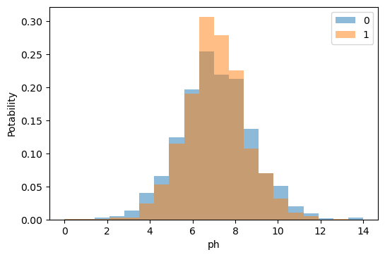
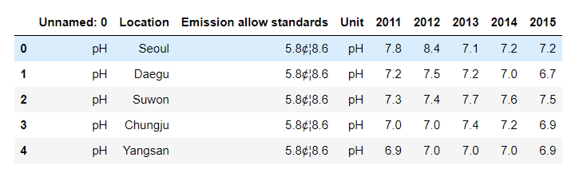
EDA

Slide 4
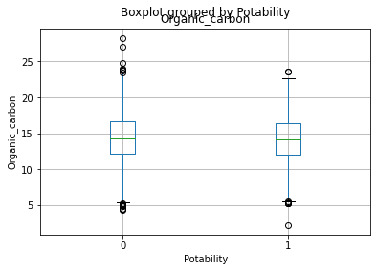
EDA
According to U.S. Environmental Protection Agency(US EPA) less than 2 mg/l is potable water, and less than 4 mg/l is use for treatment.

Slide 5
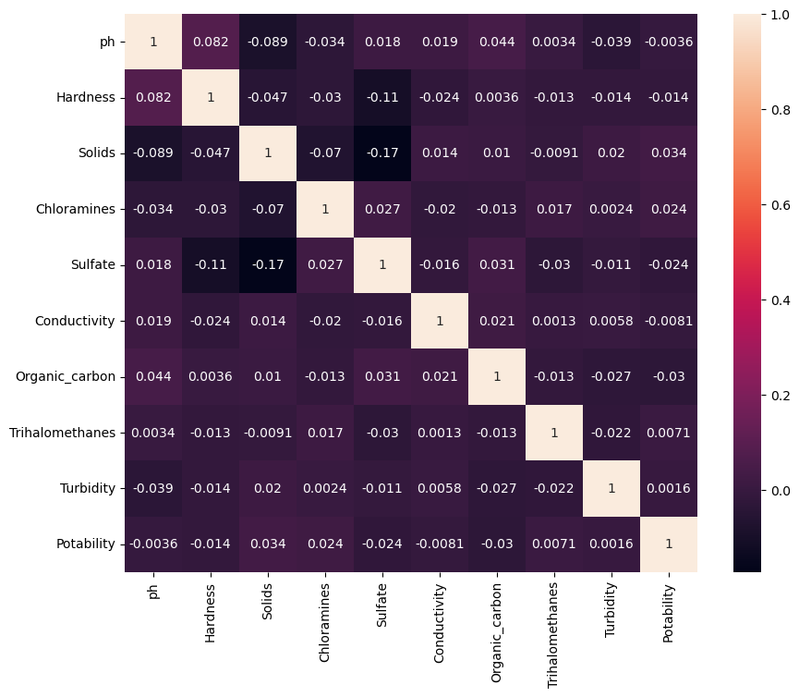
EDA

Slide 6
Splitting and Preprocessing
Splitting the dataset: The target variable is potability and there are nine features. K-Fold Split the features are independent identically distributed. Dataset was split into five folds. One is used for validation in every instance of cross-validation, and the other four folds are used for training purposes.
Preprocessor: Standard scalar
Missing values: three features has missing values.

Slide 7
Other
Korea District Heating Engineering Co., Ltd. (2020, November 20). 한국지역난방공사_시설 폐수배출농도 정보_20151231.(Korea District Heating Engineering Co., Ltd._ Facility wastewater dispose information) Retrieved October 15, 2021, from https://www.data.go.kr/data/15069597/fileData.do.

Slide 8
Q&A

Slide 9
Thank you

